Slide 1
Town Design
Anita Ovbude, Najnin Sultana, Gaylenis Mendez, Fernando Batlle, Alymeidy Sosa

Slide 2
Our Charrette Challenge: Scenario B
A wealthy citizen willed 100 undeveloped acres of wooded land bordering an urban area. In her will she designated that the land should be comprised of a mixed income community of 150 homes. Space for some shopping, doctor’s offices, restaurants, etc. should also be planned. Although streets for vehicle traffic are needed, it was her wish that it should be convenient and safe to travel by bike or on foot throughout the community.

Slide 3
Preliminary Brainstorming
We knew we wanted it to be a small and tight knit town.
More of a “suburbs” than a “city”.
There is not a great amount of space so we have to know how to organize the buildings according to dimensions and comfort
It should not be crowded because the citizen wants the community to be convenient for walking and biking

Slide 4
Role Assignments
https://docs.google.com/document/d/1MVAFMopp5LklmFTpQpiueQWS0QPun74djreqlcMlwm8/edit

Slide 5
Anita Ovbude: Chairwoman/ Urban Planner
An urban planner or city planner is a professional who works in the field of urban planning/land use planning for the purpose of optimizing the effectiveness of a community's land use and infrastructure.

Slide 6
Fernando Batlle: Civil Engineer
Civil engineers design,construct,supervise, operate, and maintain large construction projects and systems, including roads, buildings, airports, tunnels, dams, bridges, and systems for water supply and sewage treatment.

Slide 7
Najnin Sultana & Alymeidy Sosa: Landscape Architects
A Landscape architect is a person involved in the planning, design and sometimes direction of a landscape, garden, or distinct space.

Slide 8
Gaylenis Mendez: Environmental Engineer
Environmental engineers develop solutions to environmental problems. They are involved in efforts to improve recycling, waste disposal, public health, and water and air pollution control, as well as comfort and efficiency when traveling and moving around the town.

Slide 9
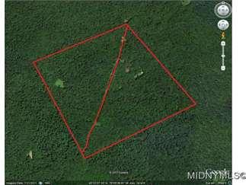
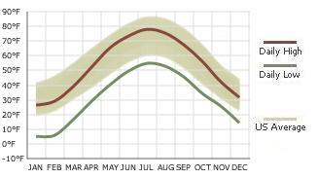
Background Info - The Location
www
Weather
Remsen, Oneida County
New York Land
100 acres
www.landwatch.com/Oneida-County-New-York-Land-for-sale/pid/299608269
The Daily high ranges from 25-78 degrees fahrenheit
The Daily low ranges from 5-53 degrees fahrenheit so we concluded that there should be heating in the buildings especially the mall and day care where most of the youth would be

Slide 10
Demographics
As of the census of 2000, there were 1,958 people,
There were 745 households out of which 36.2% had children under the age of 18 living with them, 54.1% were married couples living together, 11.5% had a female householder with no husband present, and 30.5% were non-families. 22.6% of all households were made up of individuals and 9.1% had someone living alone who was 65 years of age or older.
In the town the population was spread out with 28.1% under the age of 18, 7.3% from 18 to 24, 28.9% from 25 to 44, 24.9% from 45 to 64, and 10.9% who were 65 years of age or older.
The median income for a household in the town was $34,968, and the median income for a family was $41,042. Males had a median income of $30,938 versus $22,989 for females. The per capita income for the town was $16,394. About 8.5% of families and 11.2% of the population were below the poverty line, including 10.5% of those under age 18 and 10.4% of those age 65 or over.

Slide 11
Facilities
What buildings we want to include? Why and what placement?
Park (with pathways for walking and biking and a children’s section)
Hospitals and clinics
Schools
Community centers/senior centers
Bank
Grocery stores
Churches
Buildings for human habitation (high rise buildings because we don’t have enough land to make multiple houses next to each other. Three large buildings with 50 apartments each)
Mall including: Restaurant,Stores (pharmacies, Costco, BJ’s,GameStop, clothes, furniture, Target, Old Navy, Gap, H&M, Macy’s, etc), Ice-rinks

Slide 12
Dimensions
Dimensions of the Buildings: (100 acres - 4,356,000 square feet)
Estimate parking to be approximately 110 cars to the acre
Overall, a church building with dedicated spaces for sanctuary, fell
Education, administration and multi-use space may require from 30-55 square feet of space per person depending on programs, ministries and other factors, church ends up being ½ an acre
The Queens Center Mall is 5 acres, 221,509 square feet
The Hyde Park, London is 625 acres and Central Park is 843 acres
Average children’s playground is 1.2 acres so if we make all the parts of the park 1.2 in total we’ll have 4.8 acres, not including roads (which we haven’t decided)
Bike roads are 4-6 feet wide, while car roads are 22-24 feet wide
Average single family house 2,669 feet or .06 acres

Slide 13
Our Final Site Plan

Slide 14
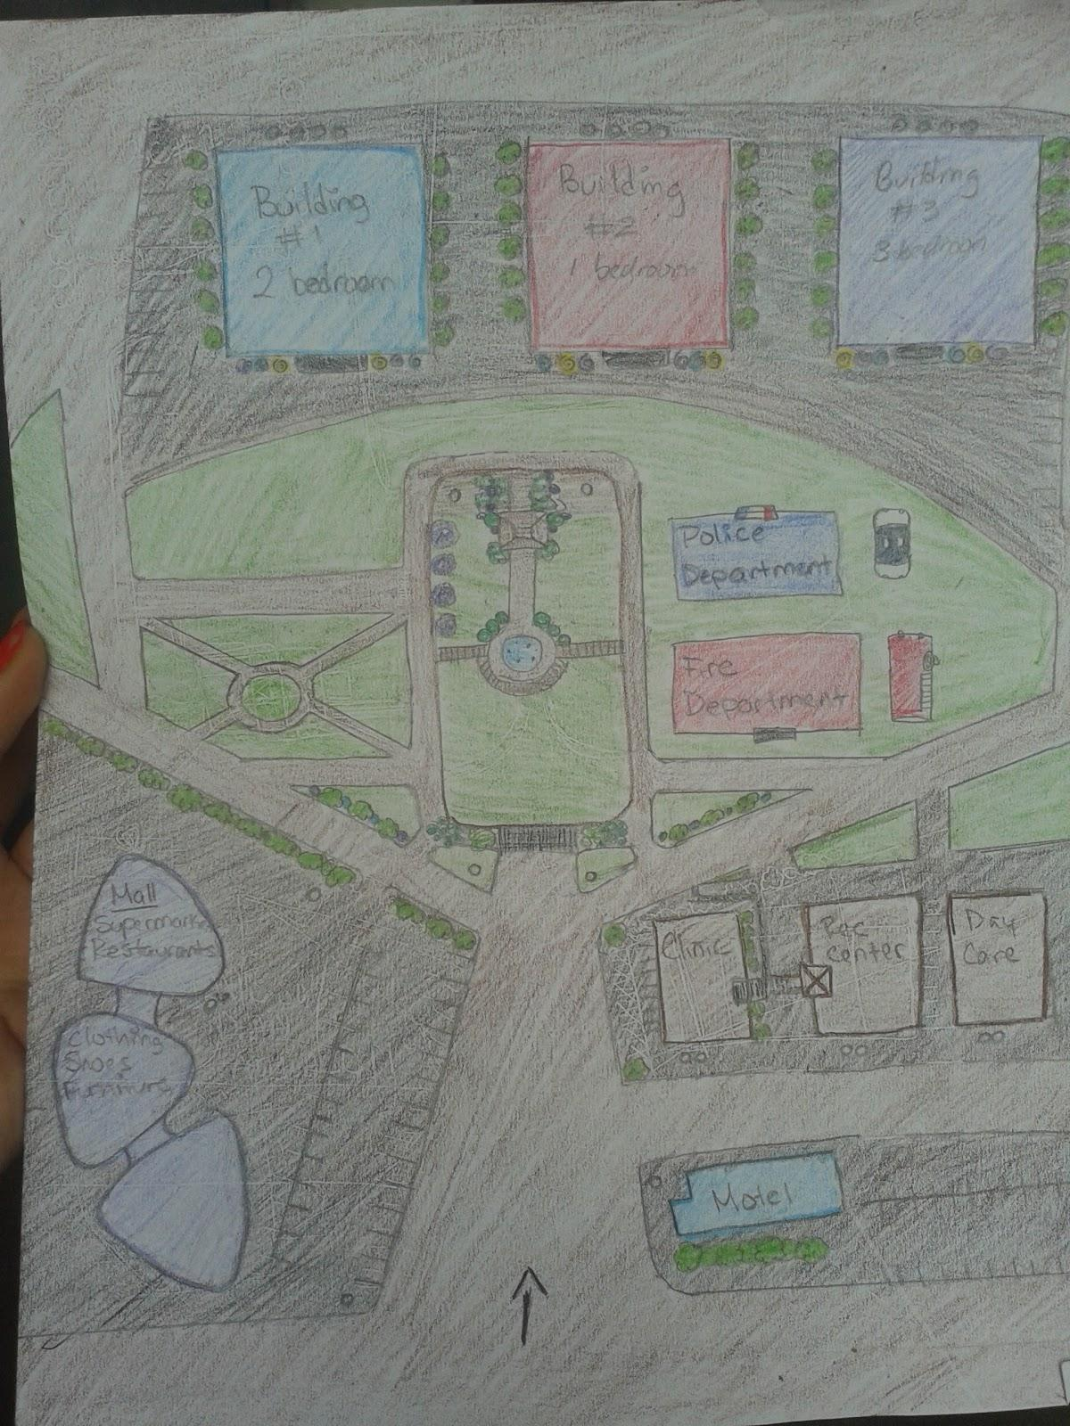
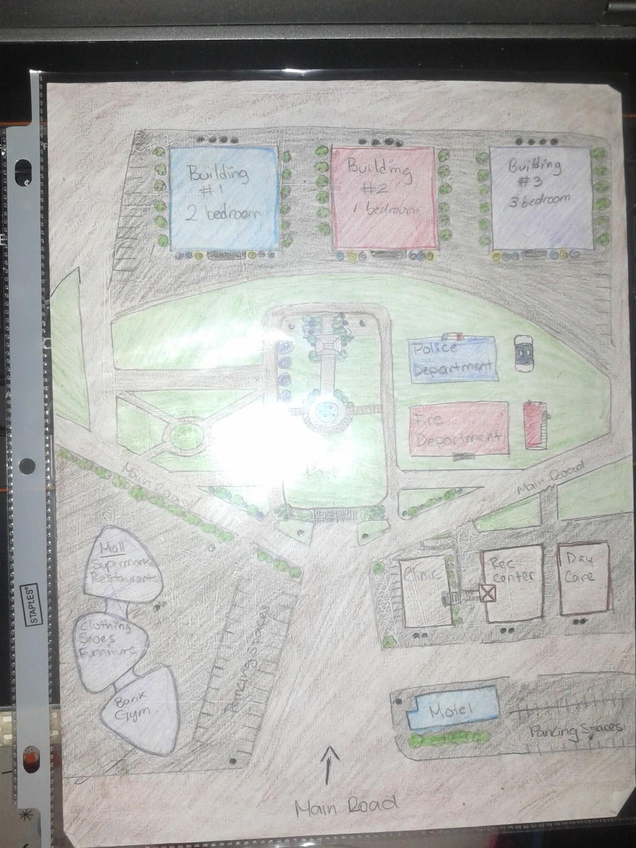

Slide 15
THE BUILDINGS:
THERE ARE THREE EACH HAVE 50 APARTMENTS, IN TOTAL 150 HOMES
2 BEDROOM, 1 BEDROOM, 3 BEDROOM
TRASHCANS AT THE BACK OF THE BUILDINGS WITH BUSHES ON THE SIDES
FIRE ESCAPES ON THE FRONT NEXT TO THE ENTRANCE, TRASH MORE LIKELY TO GET ON FIRE

Slide 16
THE PARK:
DIVIDED INTO SEVERAL PARTS INCLUDING: CHILDREN ARE, PICNIC AREA, COMMUNITY GARDEN, AND SPORTS/OPEN FIELD
FIRE DEPARTMENT CLOSEST TO THE PARK DUE TO THE HIGH RISK OF FIRE
POLICE DEPARTMENT CLOSE IN CASE OF EMERGENCY AND DISRUPTIONS, ALSO CLOSEST TO BUILDINGS TO PROVIDE ORDER
BIKE AND CAR ROADS AVAILABLE

Slide 17
THE MALL:
PROVIDED WITH PARKING SPACE FOR BIKES AND CARS
HAS SUPERMARKETS, RESTAURANTS, CLOTHING, SHOE, AND FURNITURE STORES, A BANK, AND A GYM.
THE MOTEL:
CLOSEST TO THE ROAD, IN CASE SOMEONE COMES TO VISIT A RELATIVE OR JUST WANTS TO VISIT THE MALL ETC
TO THE RIGHT THERE IS A CLINIC, A RECREATIONAL CENTER AND A DAY CARE
PARKING BEHIND THE CLINIC
ROADS THROUGHOUT FOR EASY-ACCESS

Slide 18
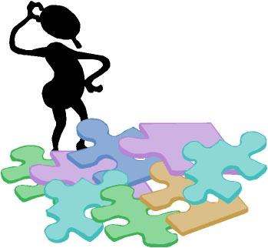
What issues are you responsible for that potentially no other stakeholders would know about?

Slide 19
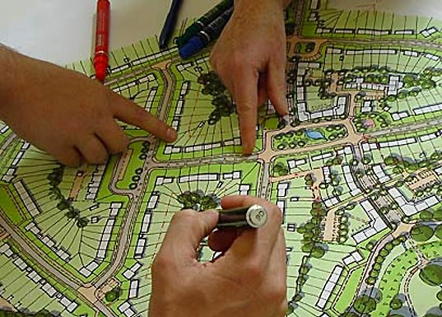
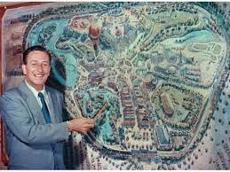
Urban Planner
My contribution to this charrette was that I was the brains behind how to use the 100 acres in a smart way, where the community can get the most out of the space they will live in and maximize each acre. For example I established..
150 homes would be stationed as 3 high rise buildings
Space for shopping, doctor’s offices, restaurant can all be built as a mall

Slide 20
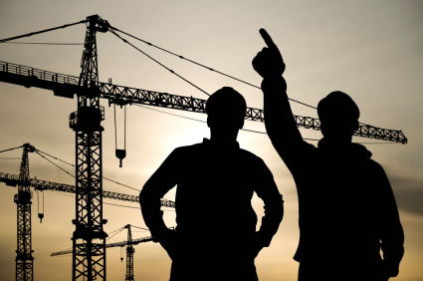
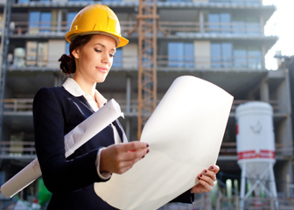
Civil Engineer
Created the roads, bike lanes and sidewalks.
Needed to make sure that the area was convenient and safe to travel by bike or on foot throughout the community.
The urban planner decided on location of buildings and structures I had to be precise in the ways the roads are laid out so that people can get to places without being blocked by buildings or having to go around a whole block.

Slide 21
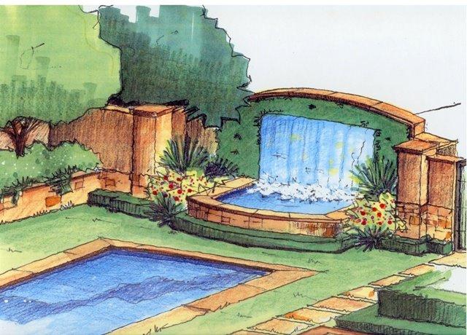
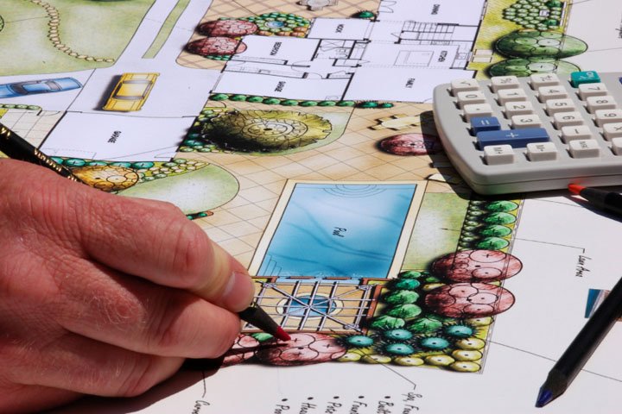
Landscape Architects
Contributed to the park and trees in the area. Planned a park with greenery and scenic views where people can take afternoon jogs, walk their dogs, have a family picnic or barbeque.
Each area had certain needs. At the park we planned a grassy area, a small pond and a few beds of flowers. For the dog walkers, we wanted bushes for the dogs to pee.
For picnics and barbeques, brought in boulders for people to sit on, similar to ones you may see at Central Park and brought in high trees to provided shade.

Slide 22
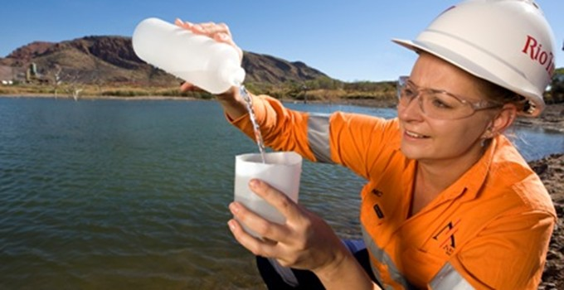
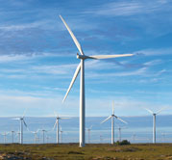
Environmental Engineer
I was responsible for the town being safe for the people and environmentally-friendly.
For the park, I wanted the boulders to be away from the children’s play area and the bike roads to be small and away from car roads to prevent crashes.
For the high-rise complex, I assured that the buildings were up to code with energy efficient windows, heaters, proper plumbing, and electricity.
That there were solar panels to power the mall so that the town has as little pollution as possible, as well as more bike roads.
First aid kits and trained facilitators are provided in all buildings in case of emergencies and proper fire escapes were included as well.

Slide 23
Problems we Faced...
Which buildings to include, because of the limited space, we could only choose the most necessary buildings
Finding the location of where to put each building
Make sure the town was safe for everyone and efficient for bicyclists and pedestrians

Slide 24
Discussion (CONT’D)
Going into the charrette, list the top 5 issues in order of importance that you wanted to address or wanted to.

Slide 25
Urban Planner
Choosing which building facilities were needed. - I asked several people what they believed were crucial in a town and also presented it to my group so we could discuss what we needed
Deciding which facilites we don’t need- Since we did not have a large amount of space we had to compromise, so I suggested we put the different facilities that were similar in the same building
Organizing the group and also making sure that everyone was staying focused since it is easy to get off track with the computers.
Making sure the agendas/ minutes were done and completed, especially since its a lot of dates that can get confusing.
Deciding which facilities were absolutely necessary.

Slide 26
Civil Engineer
Strategic placement of the buildings where the roads and building have a logical sequence to make traveling more convenient.
Deciding general locations, placement of essential locations, and space necessary to hold the townspeople.
3. Should there be bike lanes, or streets for both biking and
driving?
Where should the paths intersect?
How can I keep roads limited, with less car traffic?

Slide 27
Landscape Architects
Where would be the best location for the park?
What should be in the park/ placement?
What demographic should we focus on or how can we please all demographics?
What size should the park be?
How should we divide the park and space-bbq/picnic, playground, track for running or biking?

Slide 28
Environmental Engineer
1. How to provide energy and efficiency for the city and the people (work alongside the civil engineer)?
2. Where and how to place the fire escapes and hydrants on the buildings, the mall as well as the park since the park has the highest chance of catching on fire because of all the trees?
3. Where and how to place bike roads, so they don’t interfere with children, cars, and pedestrians?
4. Where to place trash cans and how to get a proper disposal for the apartments?
5. How to make the mall more energy efficient and size appropriate yet provide enough for a whole town?

Slide 29
Disregarded Ideas
Skatepark because there was a limited amount of space.
Houses because we have a limited space and needed to make 150 homes in total.
Pond in the middle, we needed that space for something else, a bathroom perhaps.
Buildings near the road because there would be too much noise.
Too many schools because it’s a small town, not many children, which would take up a lot of space.

Slide 30
Group Document
https://docs.google.com/document/d/19kFcyk1Wu4k_W3ZsWCarh6HOHI09LZRu2Kk9vWfuxAM/edit
Script/Presentation Outline
https://docs.google.com/document/d/1503xIyXAvXP876YOoAk6hWSFnPxMm5xkzAFAmEj7yAQ/edit

Slide 31
Bibliography
Polce, Nicolas. "Remsen, Oneida County, New York Land For Sale - 100 Acres." Land Watch. N.p., 20 Aug. 2014. Web. <http://www.landwatch.com/Oneida-County-New-York-Land-for-sale/pid/299608269>.
Anonymous. "Landscape Architecture Careers: Where Modern Meets Mother Nature." The Art Career Project. N.p., n.d. Web. 10 Oct. 2014. <http://www.theartcareerproject.com/landscape-architecture-career/586/>.
"What Is a City Planner?" American Planning Association. N.p., 31 Aug. 2005. Web. <https://www.planning.org/kidsandcommunity/whatisplanning/>
“Google Advanced Image Search”, Google Advanced Image Search, 23-27 Oct. 2014. <Web.http://www.google.com/advanced_image_search>

Slide 32
Bibliography
"United States Census Bureau." Oneida County QuickFacts from the US Census Bureau. U.S. Department of Commerce, 08 July 2014. Web. 24 Oct. 2014. <http://quickfacts.census.gov/qfd/states/36/36065.html>.
“Remsen, New York” Wikipedia. N.p. 30 July 2014. <http://en.wikipedia.org/wiki/Remsen,_New_York#Demographics>

